Slide 1
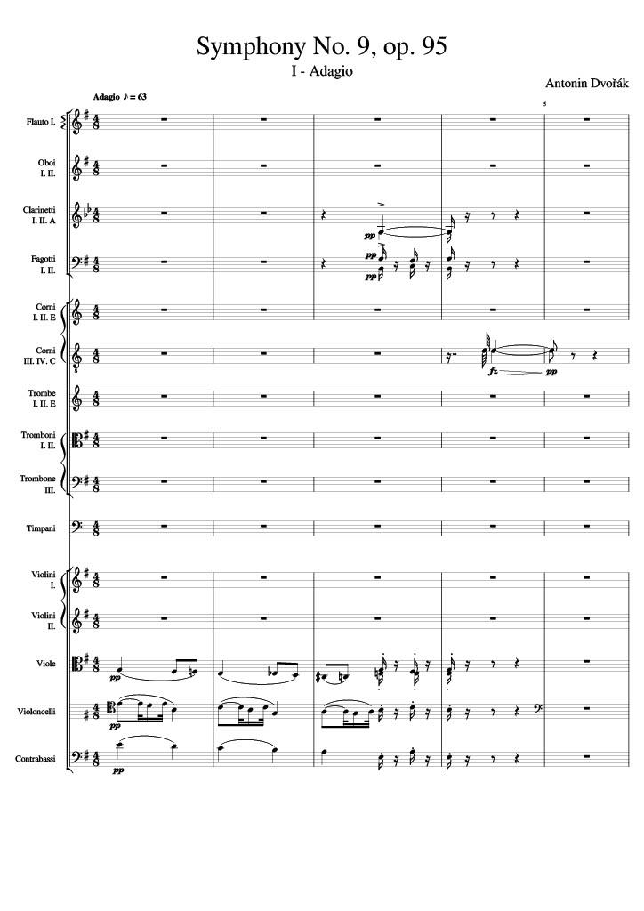
harm
rhythm+harm
mel
harm
rhythm+harm
mel
harm
rhythm+harm
Notes:
0-10
0:11

Slide 2
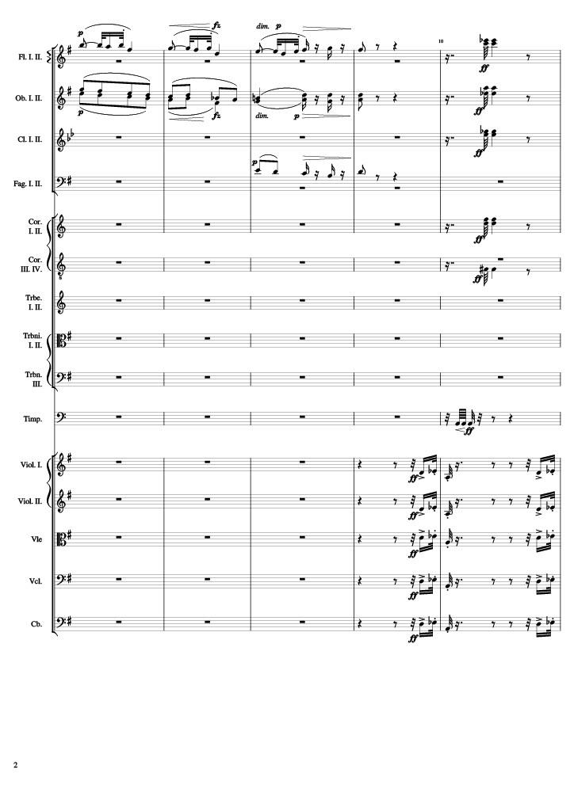
mel
rhythm+harm
harm
rhythm+harm
rhythm+harm
rhythm+harm
harm
rhythm+harm
rhythm+harm
rhythm+harm
rhythm
mel
mel
mel
mel
mel
Notes:
10-20
0:45

Slide 3
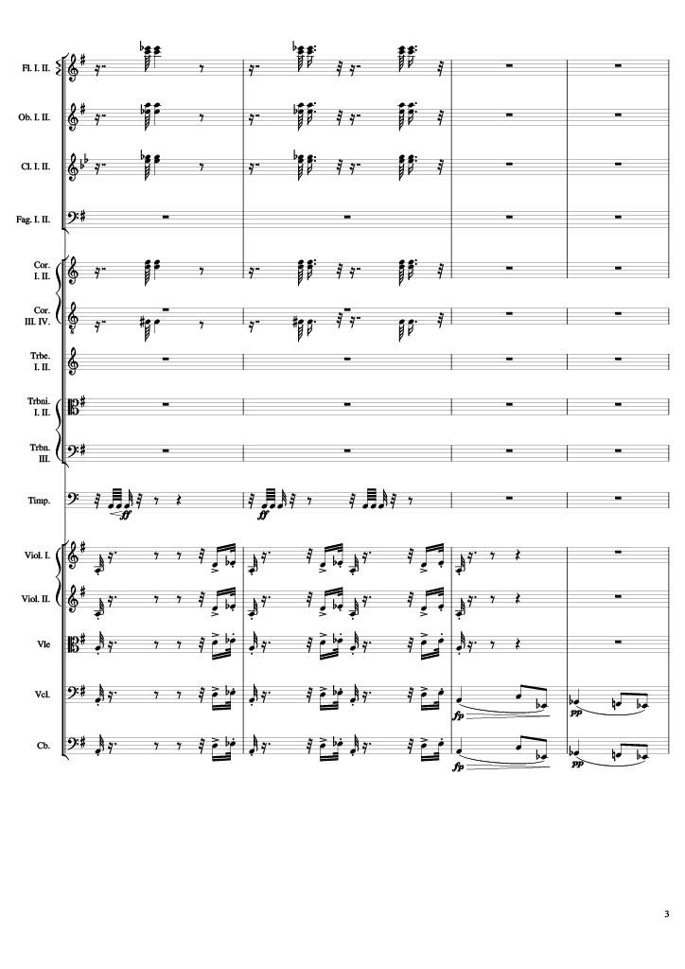
rhythm+harm
rhythm+harm
rhythm+harm
rhythm+harm
rhythm+harm
rhythm
mel
mel
mel
mel
mel
mel
mel
Notes:
20-28
1:14

Slide 4
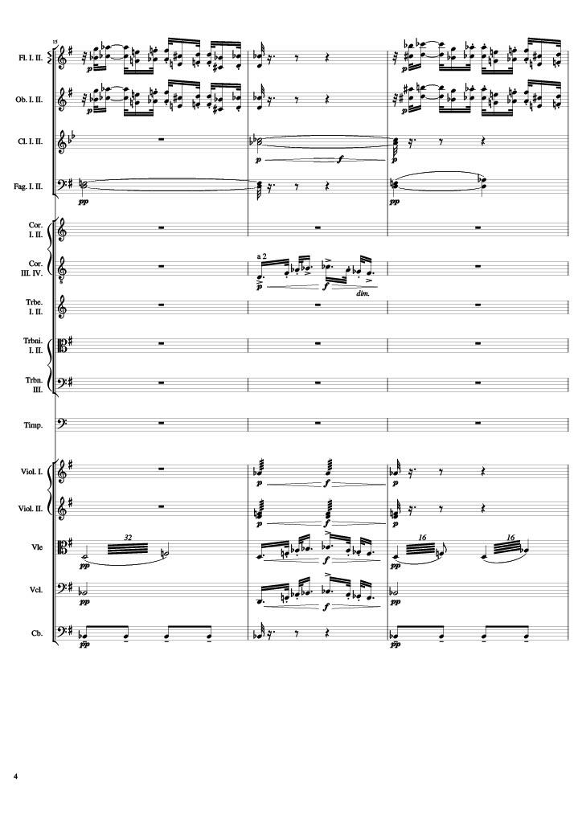
mel
mel
harm
harm
mel
rhythm+harm
rhythm+harm
rhythm
mel
rhythm
harm
mel
harm
rhythm
Notes:
28-34
1:31

Slide 5
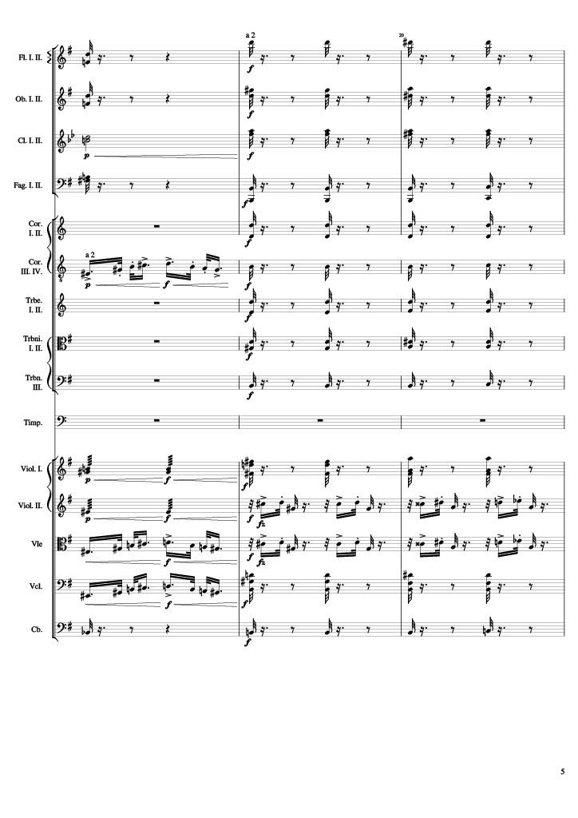
mel
rhythm+harm
mel
rhythm+harm
harm
rhythm+harm
harm
rhythm+harm
rhythm+harm
mel
rhythm+harm
rhythm+harm
rhythm+harm
rhythm+harm
rhythm+harm
rhythm+harm
rhythm+harm
mel
mel
mel
rhythm+harm
rhythm
rhythm+harm
Notes:
34-40
1:43

Slide 6
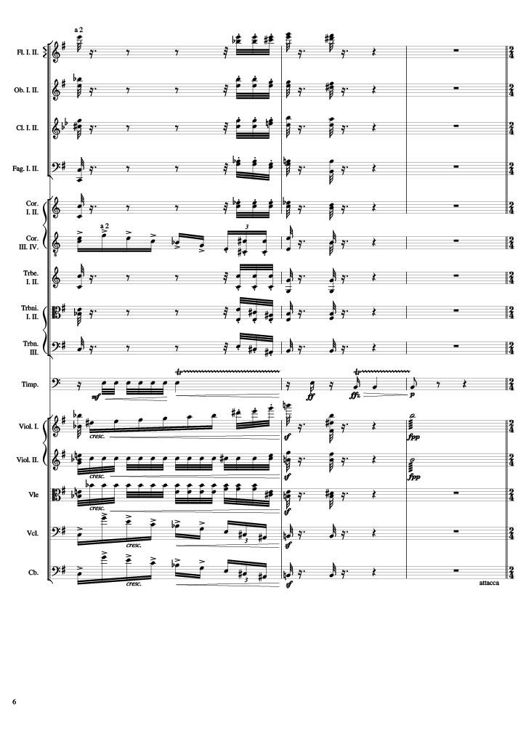
rhythm+harm
rhythm+harm
rhythm+harm
rhythm+harm
rhythm+harm
mel
rhythm+harm
rhythm+harm
rhythm+harm
rhythm
mel
rhythm
rhythm
rhythm
rhythm
rhythm
rhythm
Notes:
40-46
1:54

Slide 7
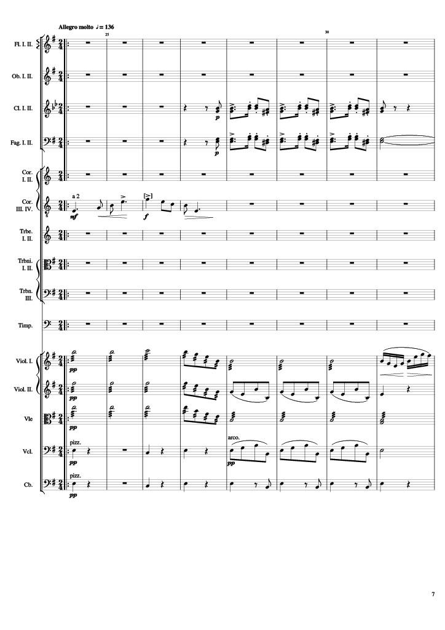
mel
mel
mel
rhythm
mel
rhythm
rhythm
rhythm+harm
rhythm
rhythm+harm
Notes:
46-62
360-376
2:06
4:42

Slide 8
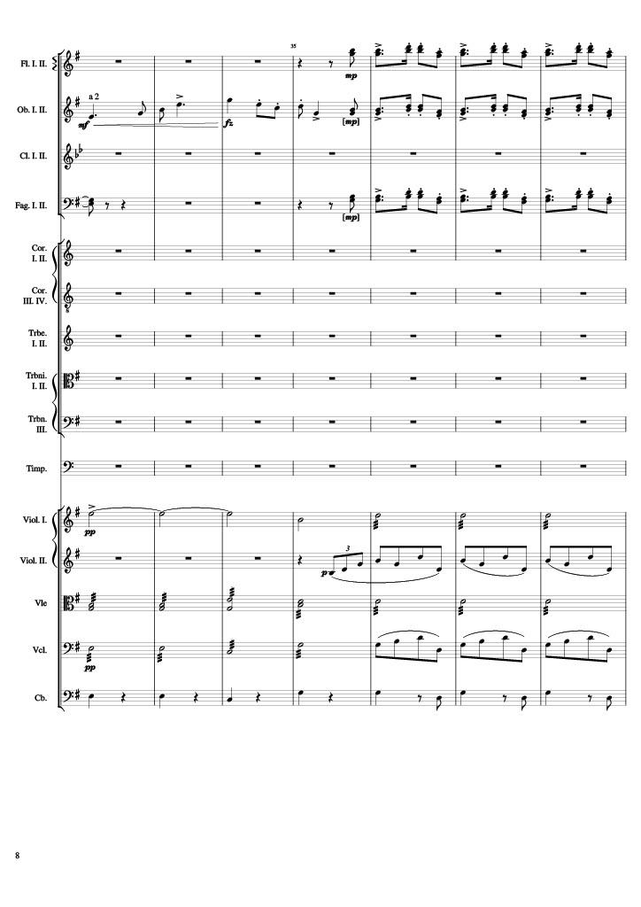
mel
mel
mel
mel
mel
mel
rhythm
rhythm
rhythm
rhythm
rhythm+harm
Notes:
62-76
376-390
2:13
4:49

Slide 9
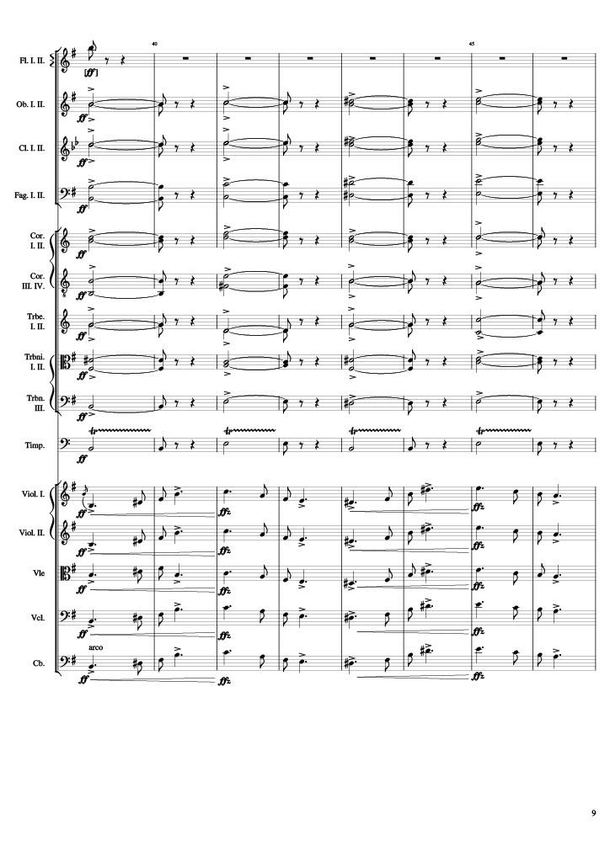
mel
harm
harm
harm
harm
harm
harm
harm
harm
rhythm
mel
mel
mel
mel
mel
Notes:
76-92
390-406
2:20
4:56

Slide 10
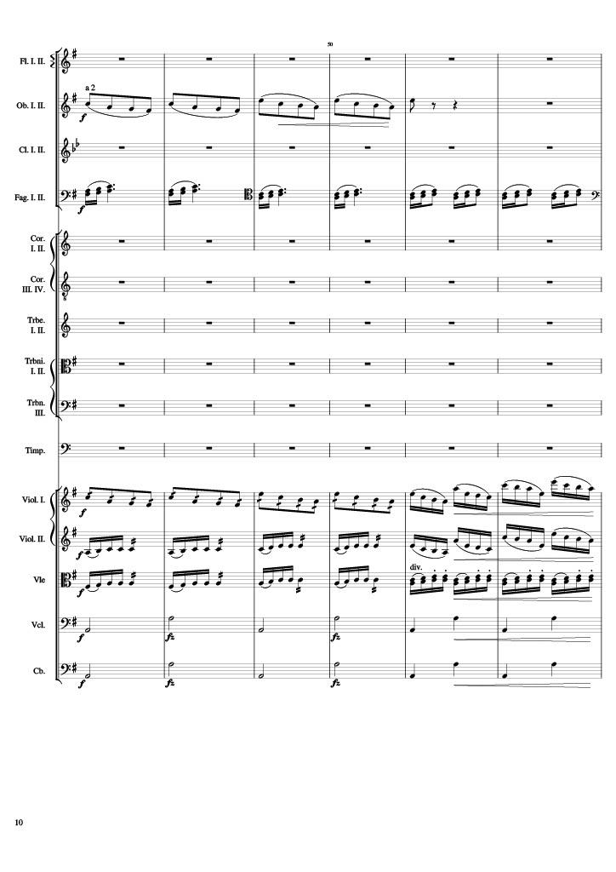
mel
rhythm
mel+rhythm
rhythm
mel+rhythm
rhythm
rhythm+harm
rhythm+harm
Notes:
92-104
406-418
2:27
5:03

Slide 11
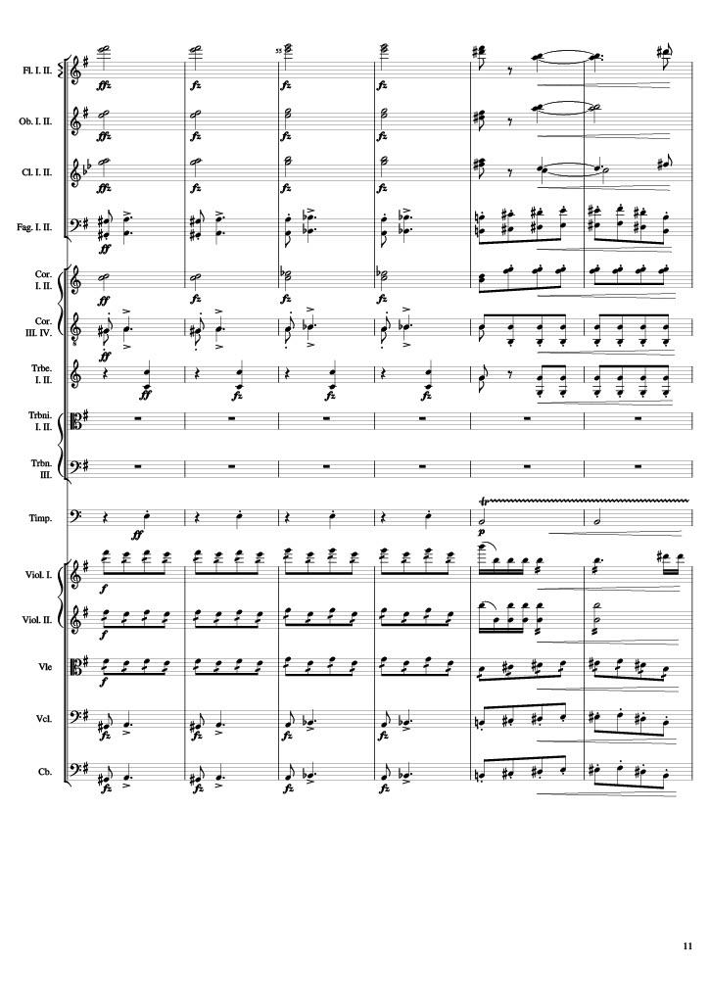
harm
rhythm+harm
harm
rhythm+harm
harm
rhythm+harm
rhythm
harm
rhythm
rhythm
rhythm
rhythm
mel+rhythm
mel+rhythm
mel+rhythm
rhythm
rhythm
rhythm
Notes:
104-116
418-430
2:32
5:09

Slide 12
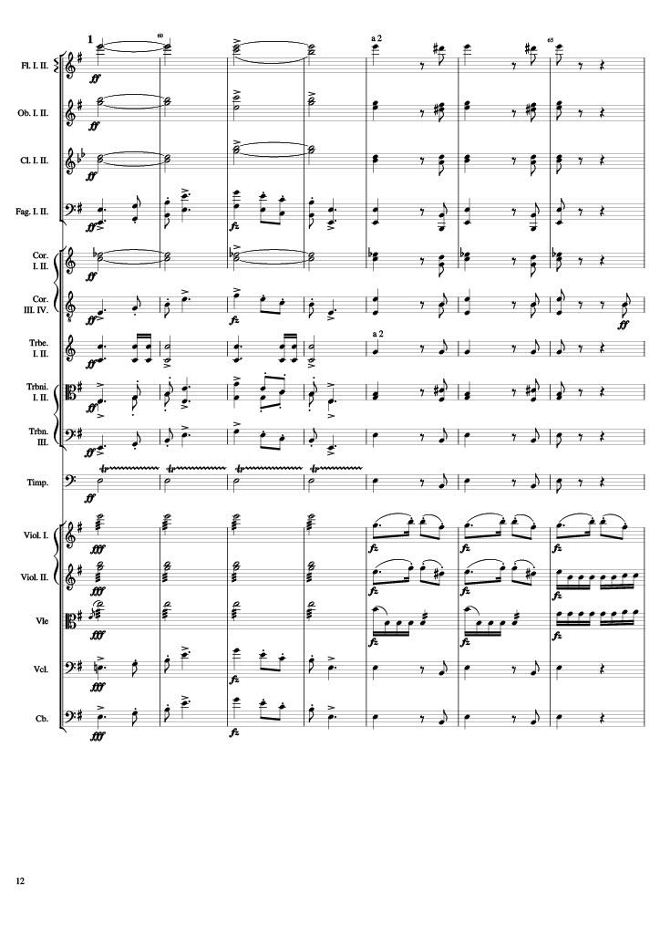
harm
rhythm+harm
harm
rhythm+harm
harm
rhythm+harm
mel
rhythm+harm
harm
rhythm+harm
mel
rhythm+harm
rhythm
rhythm+harm
mel
rhythm+harm
mel
rhythm+harm
rhythm
rhythm+harm
rhythm
mel
rhythm
mel
rhythm
rhythm
rhythm
mel
rhythm+harm
mel
rhythm+harm
Notes:
116-130
430-444
2:38
5:14

Slide 13
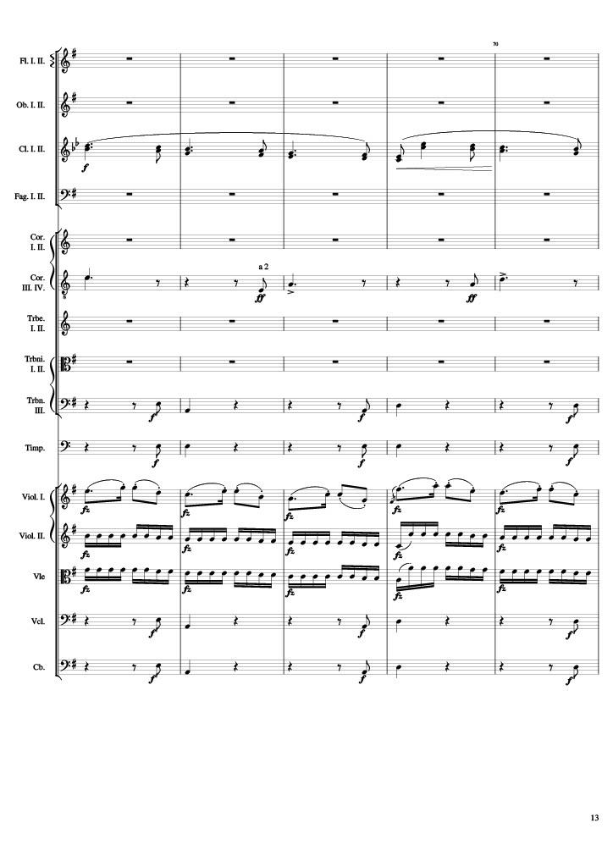
mel
rhythm+harm
rhythm+harm
rhythm+harm
mel
rhythm
rhythm
rhythm+harm
rhythm+harm
Notes:
130-140
444-454
2:45
5:21

Slide 14
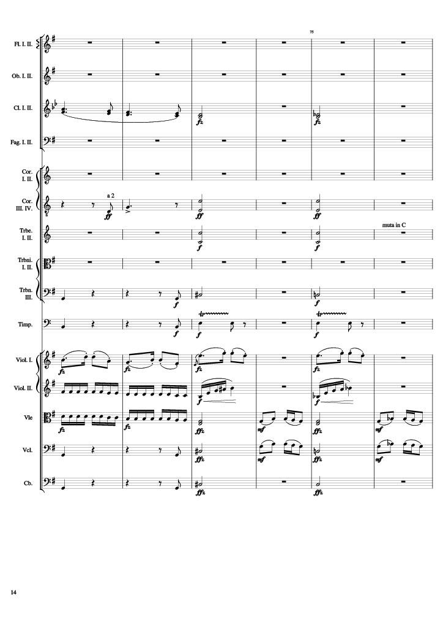
mel
rhythm+harm
rhythm+harm
rhythm+harm
rhythm+harm
rhythm+harm
rhythm+harm
rhythm+harm
rhythm+harm
rhythm+harm
rhythm
rhythm
mel
mel
rhythm
rhythm
rhythm
rhythm+harm
mel
rhythm+harm
mel
rhythm+harm
mel
rhythm+harm
mel
rhythm+harm
rhythm+harm
Notes:
140-152
454-466
2:49
5:25

Slide 15
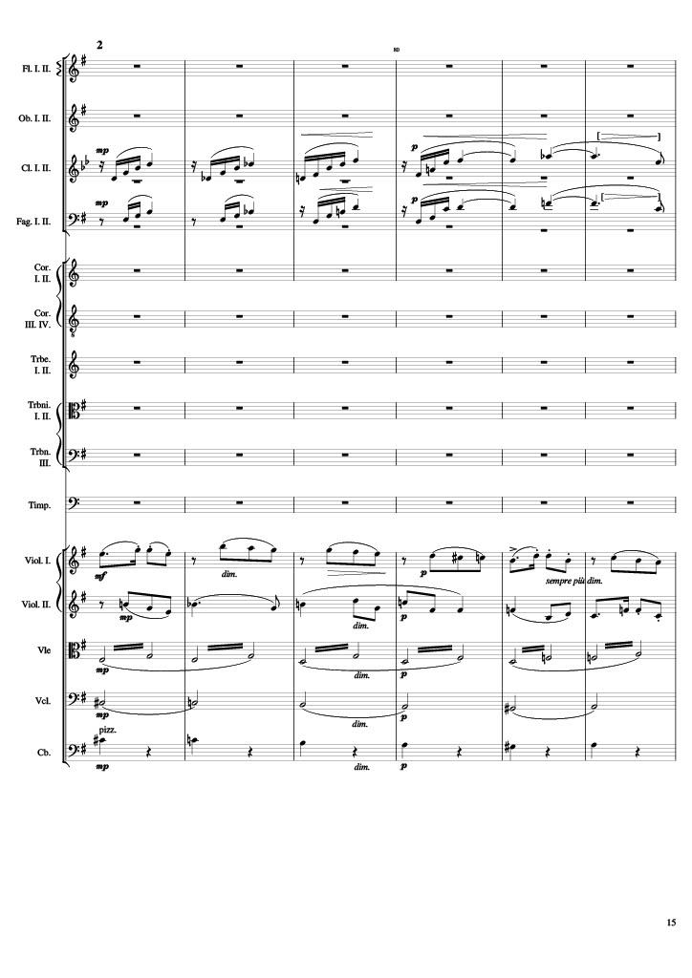
mel
mel
mel
rhythm
mel
rhythm
harm
rhythm+harm
Notes:
152-164
466-478
2:55
5:31

Slide 16
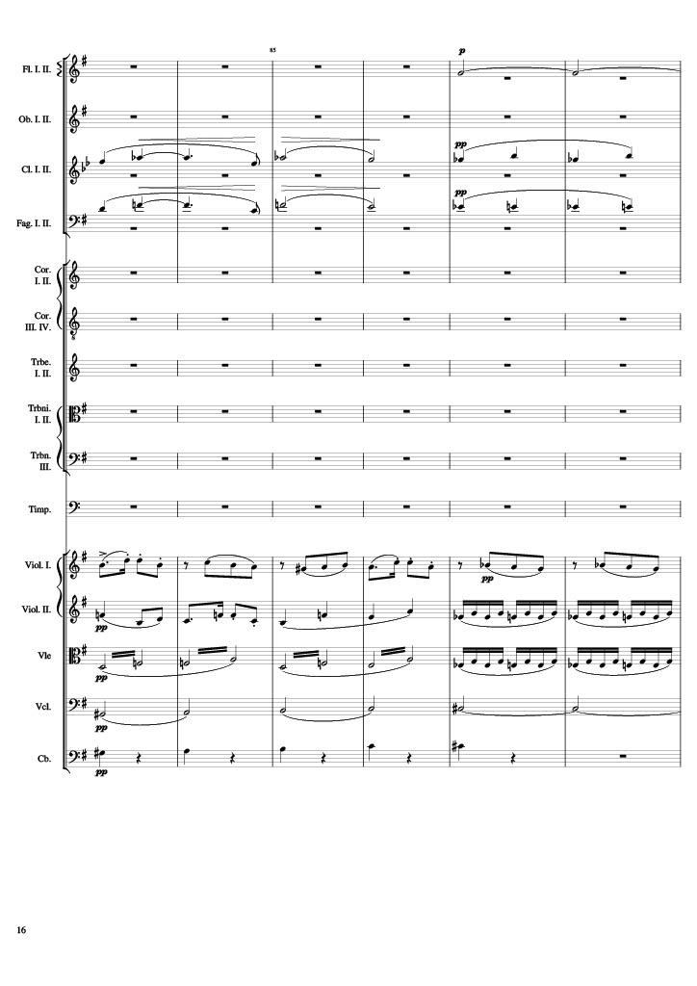
harm
mel
mel
rhythm
mel
rhythm
rhythm
harm
rhythm+harm
Notes:
164-176
478-490
3:01
5:37

Slide 17
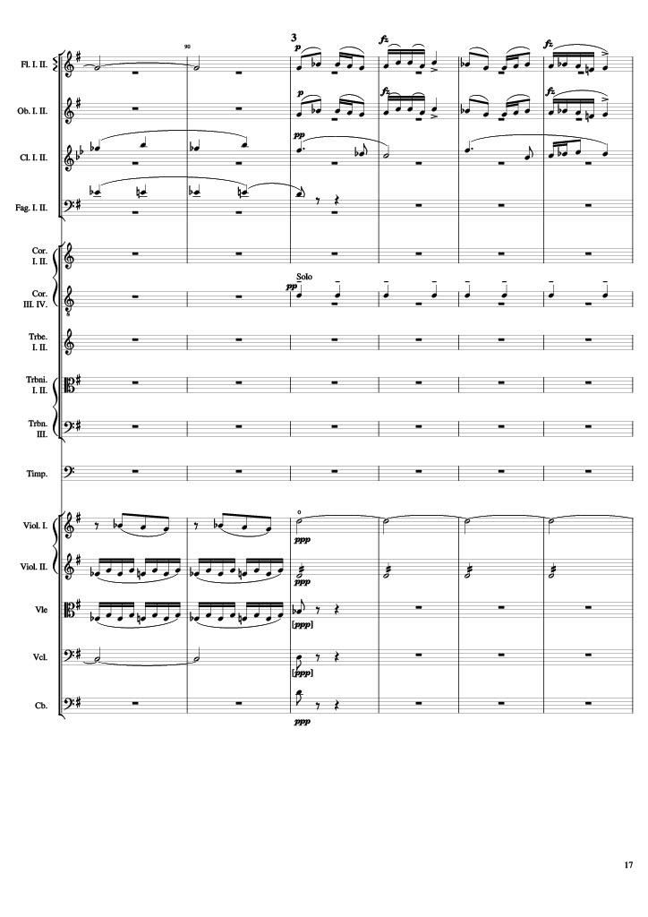
harm
mel
mel
mel
mel
mel
rhythm
rhythm
harm
rhythm
rhythm
harm
rhythm+harm
Notes:
176-188
490-502
3:06
5:43

Slide 18
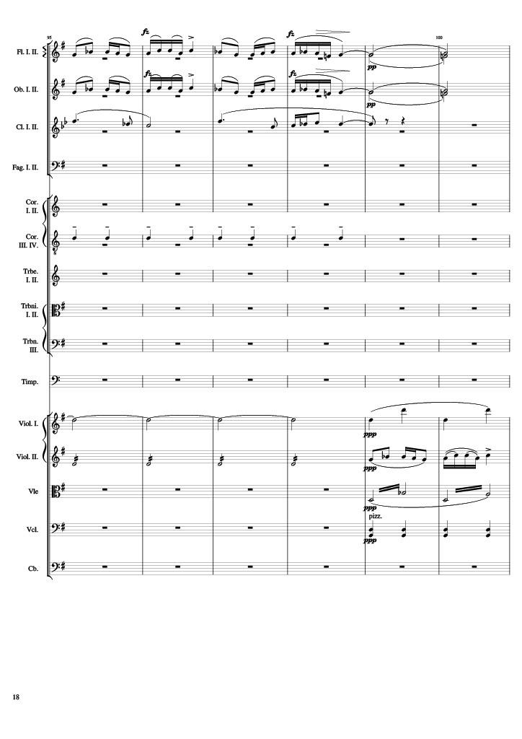
mel
harm
mel
harm
mel
rhythm
harm
rhythm
rhythm
mel
rhythm
rhythm
Notes:
188-200
502-514
3:12
5:49

Slide 19
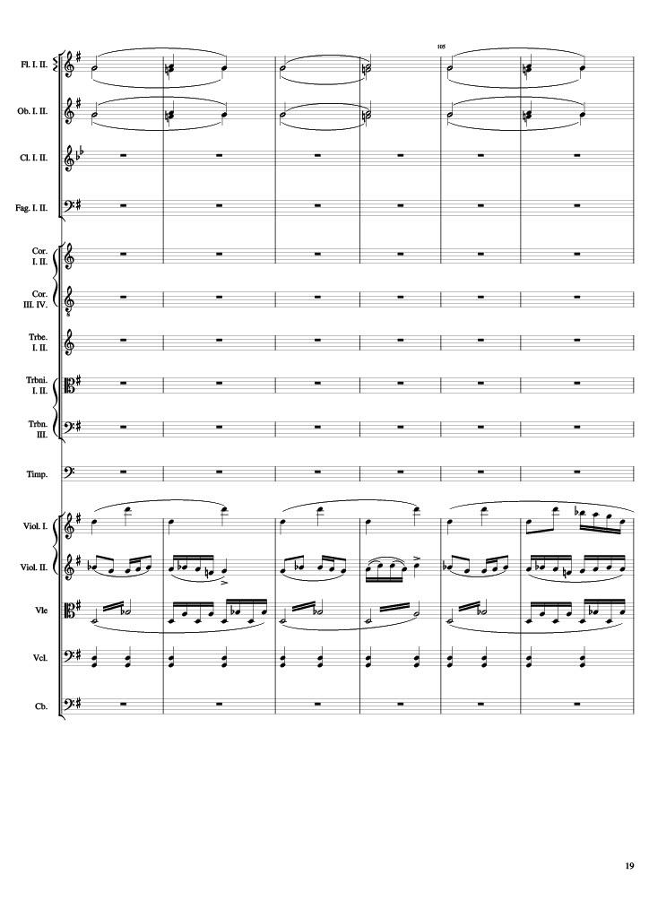
harm
harm
rhythm
mel
rhythm
rhythm
Notes:
200-212
514-526
3:18
5:55

Slide 20
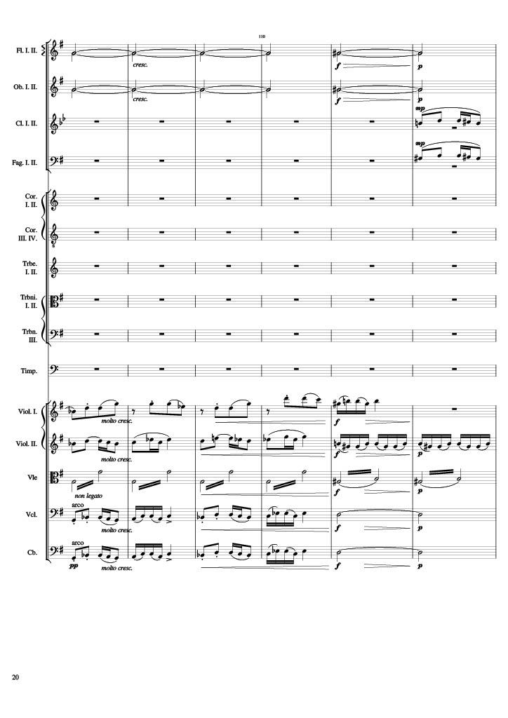
harm
harm
mel
mel
rhythm
mel
mel
rhythm
rhythm
mel
harm
mel
harm
Notes:
212-224
526-538
3:24
6:01

Slide 21
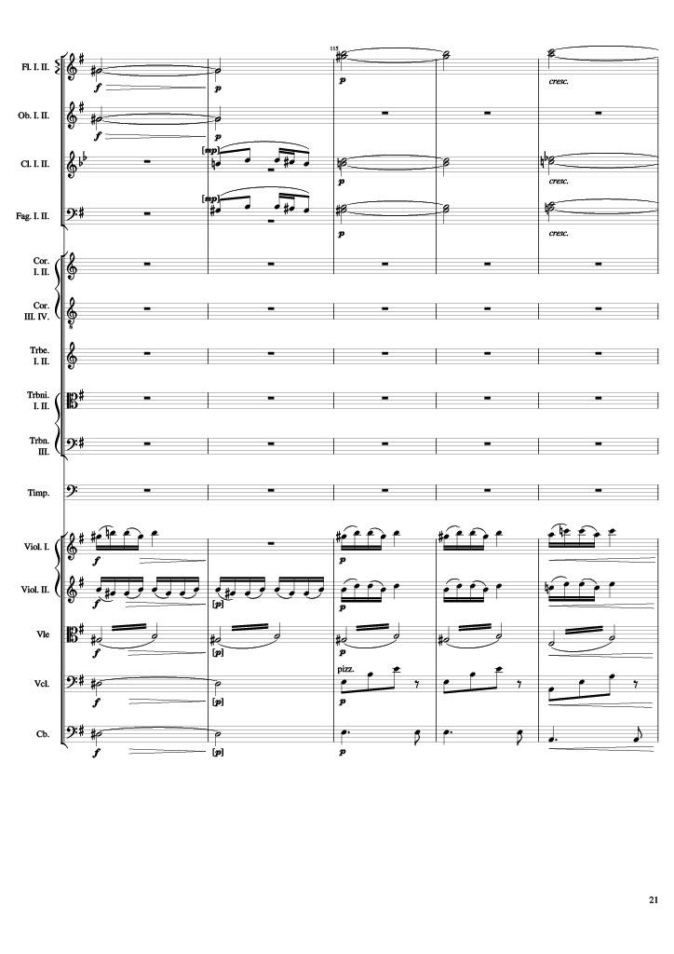
harm
harm
mel
harm
mel
harm
mel
mel
rhythm
mel
rhythm
harm
rhythm
harm
rhythm
Notes:
224-234
538-548
3:28
6:06

Slide 22
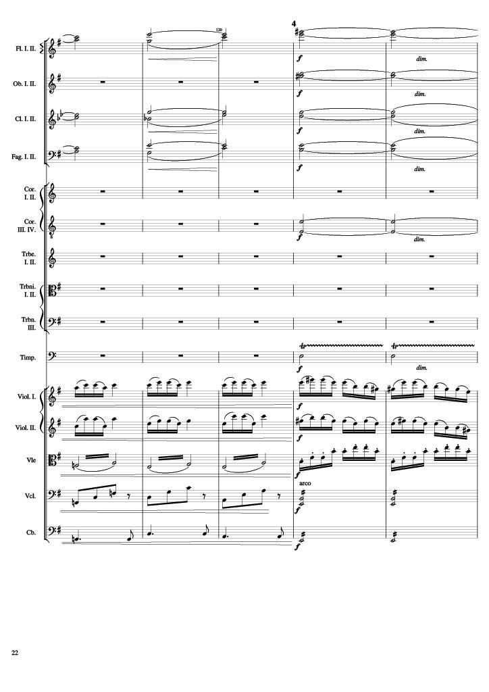
harm
harm
harm
harm
harm
rhythm
mel
mel
rhythm
rhythm
rhythm
Notes:
234-244
548-558
3:35
6:12

Slide 23
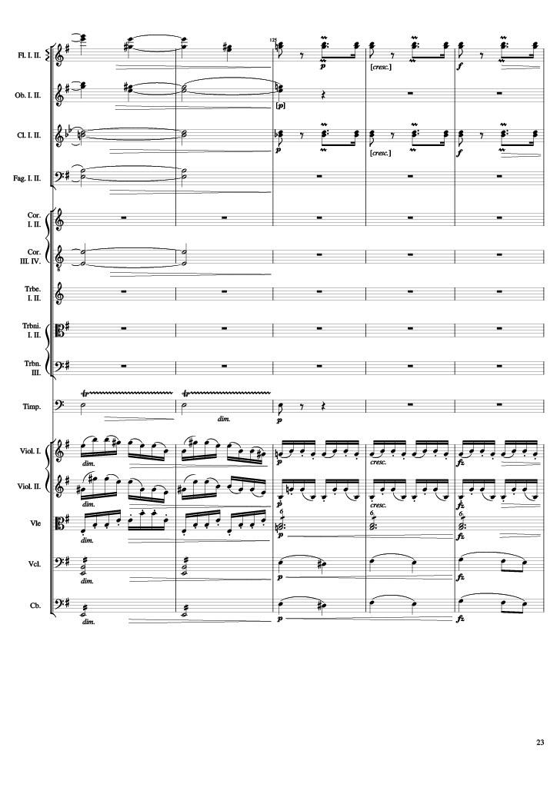
harm
rhythm
harm
harm
rhythm
harm
harm
rhythm
mel
rhythm
mel
rhythm
rhythm
rhythm
mel
rhythm
mel
Notes:
244-254
558-568
3:40
6:17

Slide 24
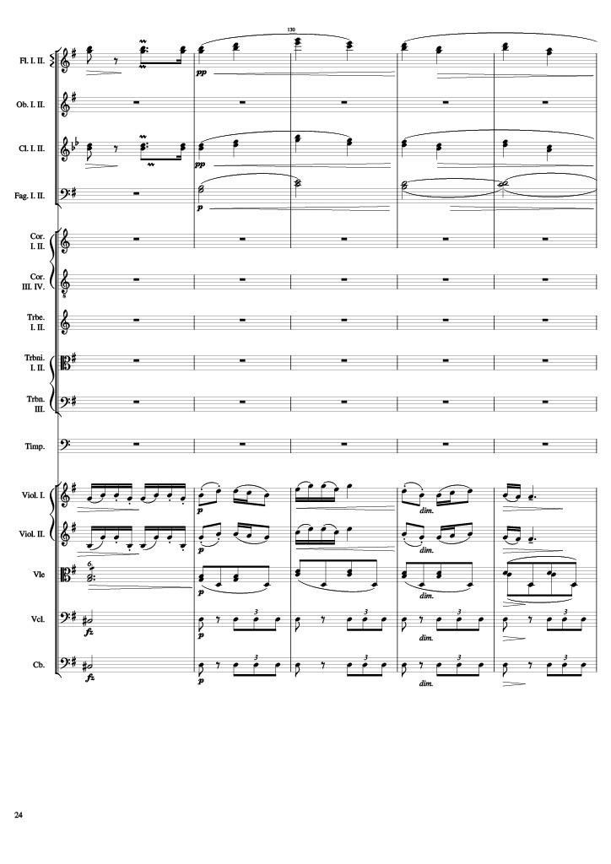
rhythm
mel
rhythm
mel
harm
rhythm
mel
rhythm
mel
rhythm
mel
rhythm
mel
rhythm
Notes:
254-264
568-578
3:46
6:22

Slide 25
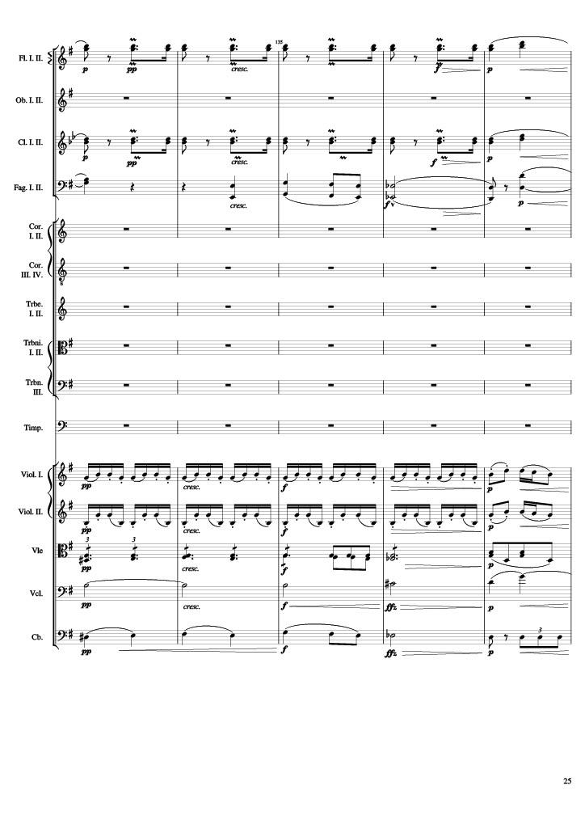
rhythm
mel
rhythm
mel
harm
mel
harm
rhythm
mel
rhythm
mel
rhythm
harm
mel
rhythm
Notes:
264-274
578-588
3:50
6:27

Slide 26
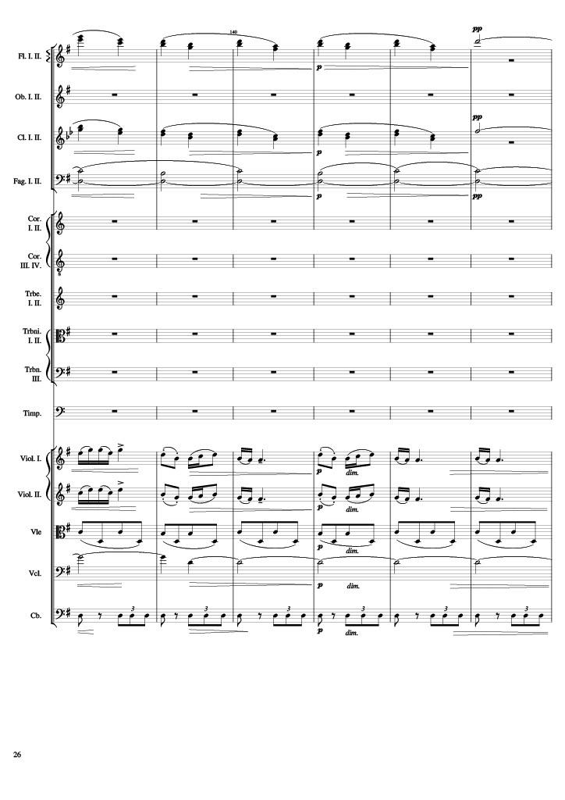
mel
mel
harm
mel
mel
rhythm
harm
rhythm
Notes:
274-286
588-600
3:55
6:32

Slide 27
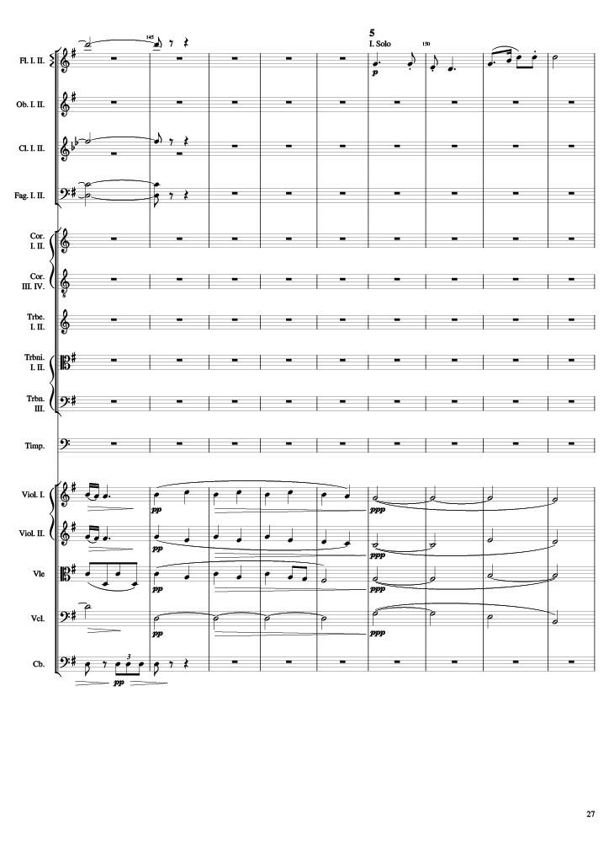
mel
mel
mel
harm
mel
harm
mel
harm
rhythm
mel
harm
harm
rhythm
Notes:
286-304
600-618
4:00
6:38

Slide 28
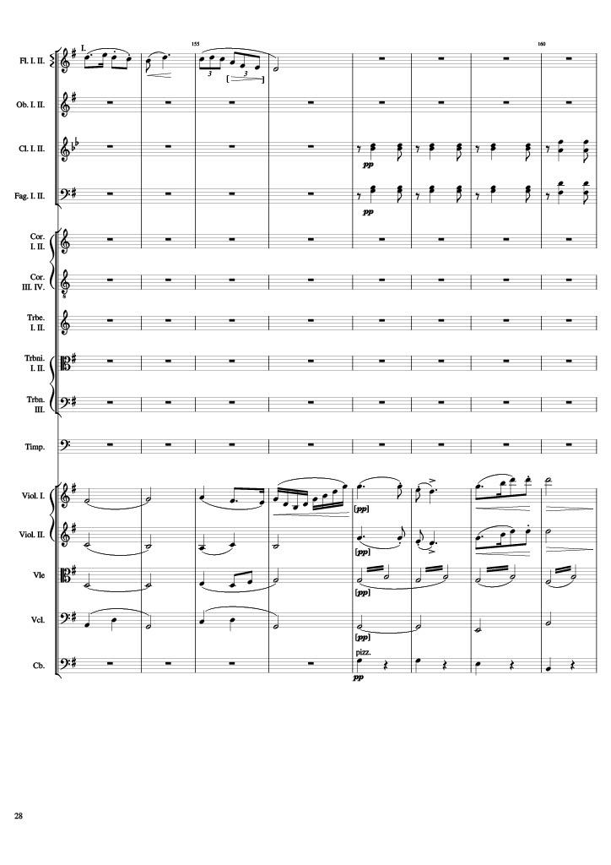
mel
rhythm
rhythm
harm
rhythm
mel
harm
mel
harm
rhythm
harm
harm
rhythm+harm
Notes:
304-320
618-634
4:12
6:49

Slide 29
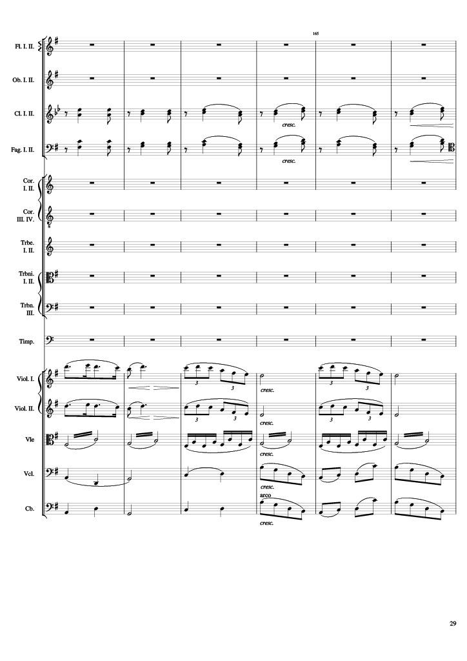
rhythm
rhythm
mel
mel
rhythm
harm
rhythm
rhythm+harm
rhythm
Notes:
320-332
634-646
4:21
6:59

Slide 30
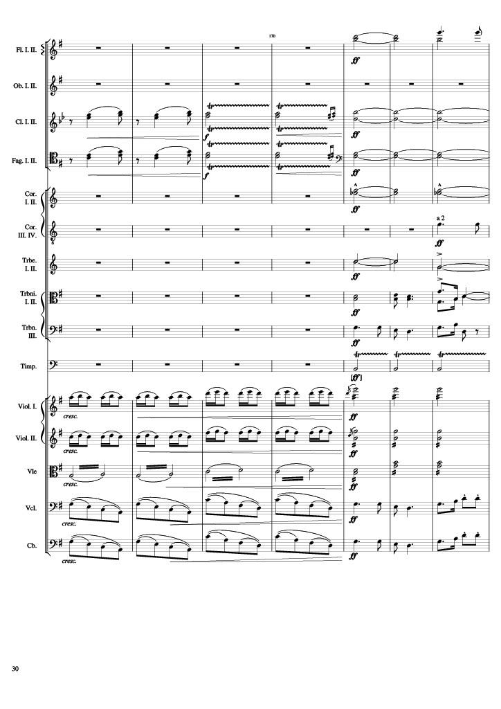
harm
mel
harm
rhythm
harm
rhythm
harm
harm
mel
harm
mel
mel
rhythm
mel
rhythm
mel
rhythm
rhythm
rhythm
rhythm
mel
rhythm
mel
Notes:
332-346
646-660
4:28
7:05

Slide 31
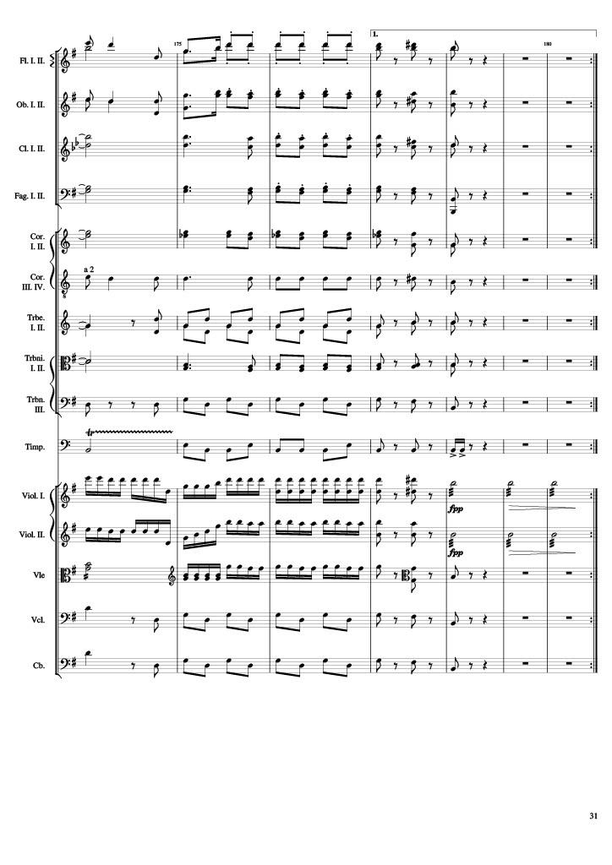
mel
rhythm
rhythm+harm
harm
mel
rhythm
rhythm+harm
harm
rhythm
rhythm+harm
harm
rhythm
rhythm+harm
harm
rhythm
rhythm+harm
mel
rhythm
rhythm+harm
harm
rhythm
rhythm+harm
mel
rhythm
rhythm+harm
mel
rhythm
rhythm+harm
rhythm
rhythm+harm
rhythm
rhythm+harm
rhythm
rhythm
rhythm+harm
rhythm
rhythm
rhythm+harm
mel
rhythm
rhythm+harm
mel
rhythm
rhythm+harm
Notes:
346-360
660-666
4:35
7:12

Slide 32
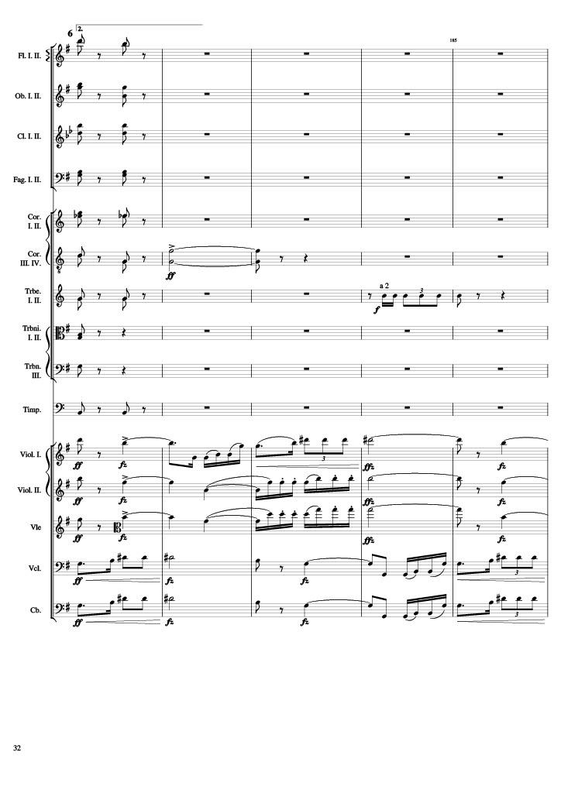
rhythm+harm
rhythm+harm
rhythm+harm
rhythm+harm
rhythm+harm
rhythm+harm
harm
rhythm+harm
rhythm
rhythm+harm
rhythm+harm
rhythm+harm
mel
mel
mel
mel
mel
Notes:
666-676
7:15

Slide 33
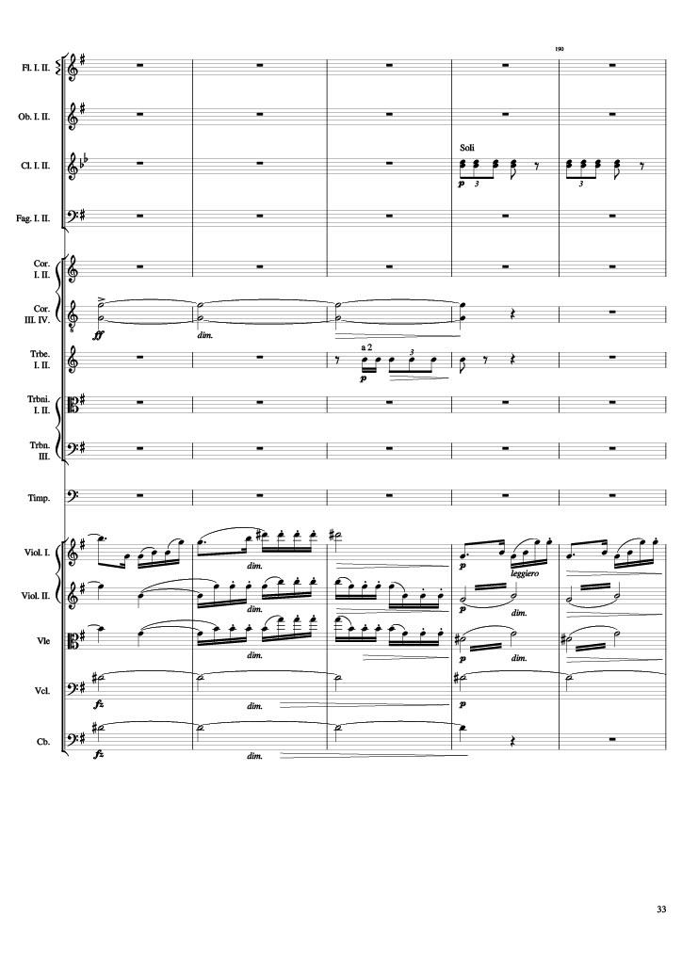
rhythm
harm
rhythm
mel
rhythm
mel
rhythm
mel
rhythm
harm
harm
Notes:
676-686
7:20

Slide 34
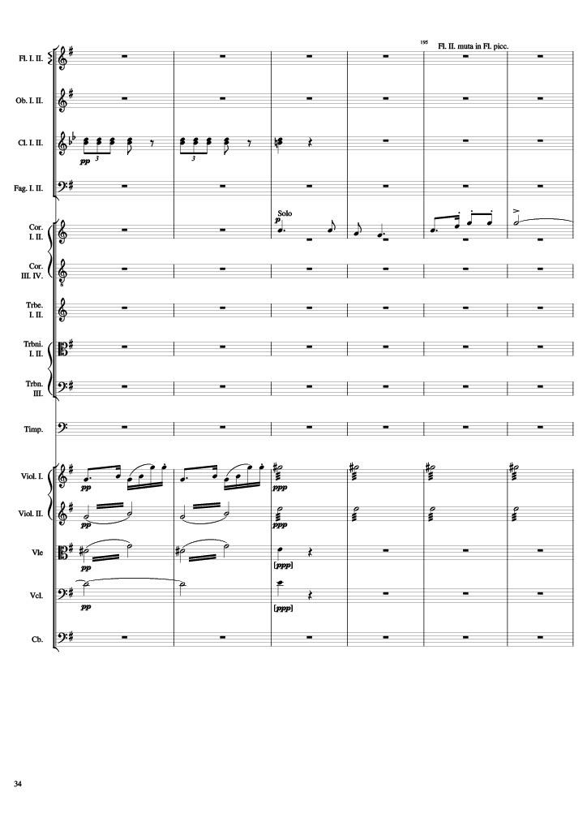
rhythm
mel
rhythm
rhythm+harm
rhythm
rhythm+harm
rhythm
harm
Notes:
686-698
7:25

Slide 35
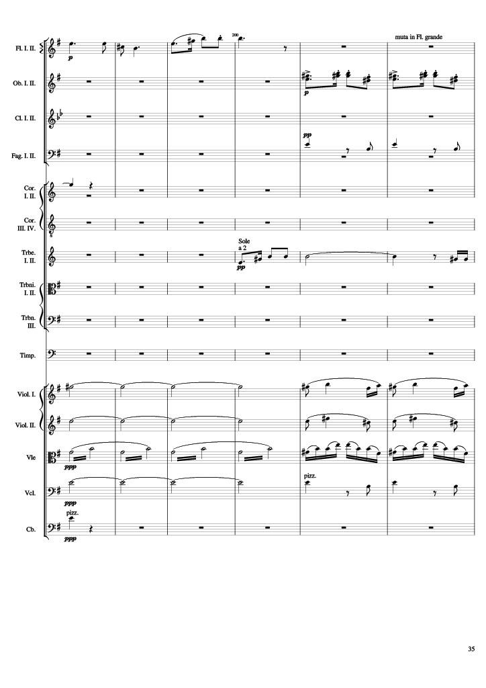
mel
mel
rhythm+harm
mel
mel
rhythm
harm
mel
harm
mel
rhythm
harm
rhythm+harm
rhythm+harm
Notes:
698-710
7:31

Slide 36
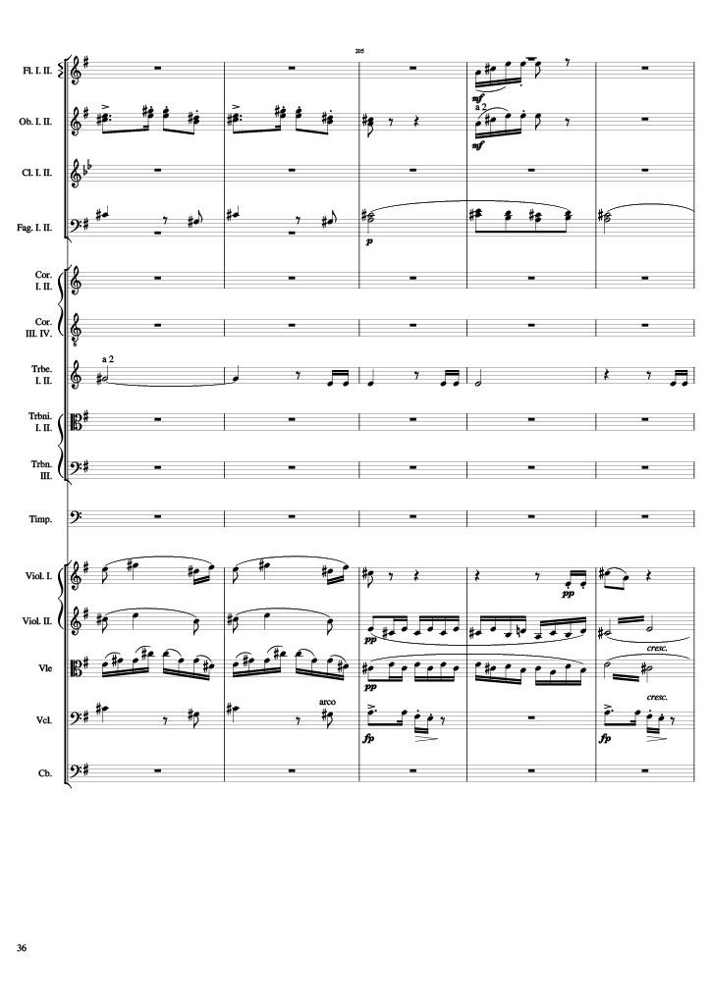
mel
mel
mel
rhythm+harm
rhythm
rhythm
mel
mel
mel
rhythm
rhythm
rhythm+harm
mel
mel
Notes:
710-720
7:37

Slide 37
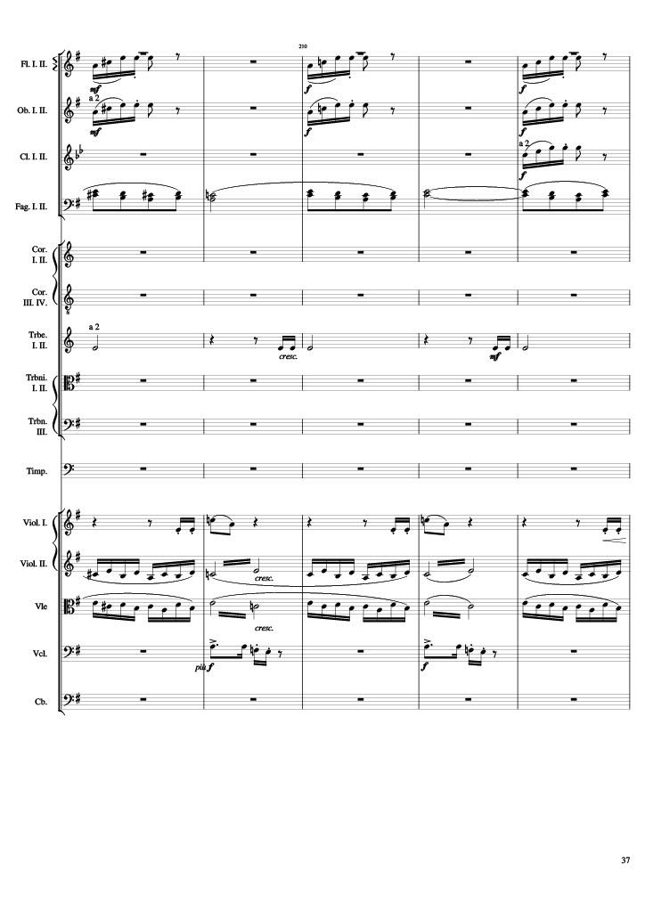
mel
mel
mel
mel
mel
mel
mel
rhythm
rhythm
mel
mel
mel+rhythm
rhythm
rhythm
mel
mel
Notes:
720-730
7:42

Slide 38
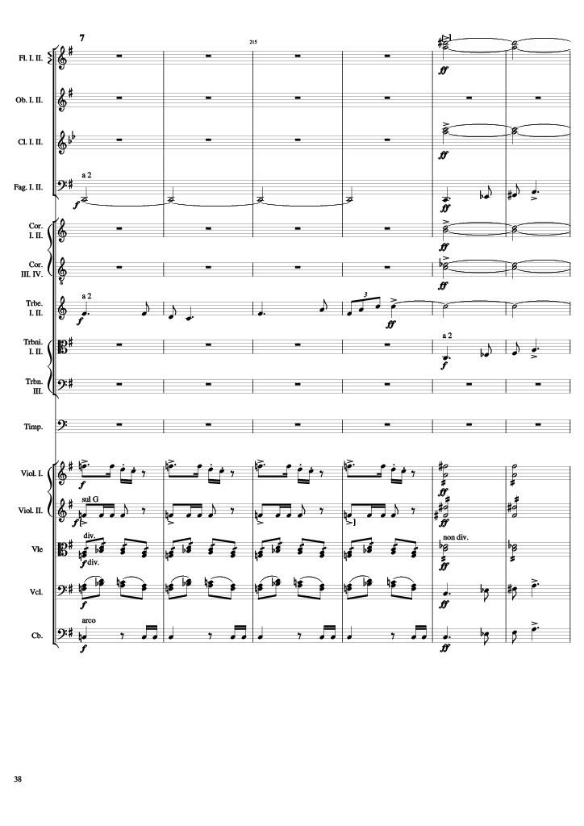
harm
harm
harm
mel
harm
harm
mel
harm
mel
mel+rhythm
rhythm
rhythm
rhythm
rhythm
mel
rhythm
mel
Notes:
730-742
7:47

Slide 39
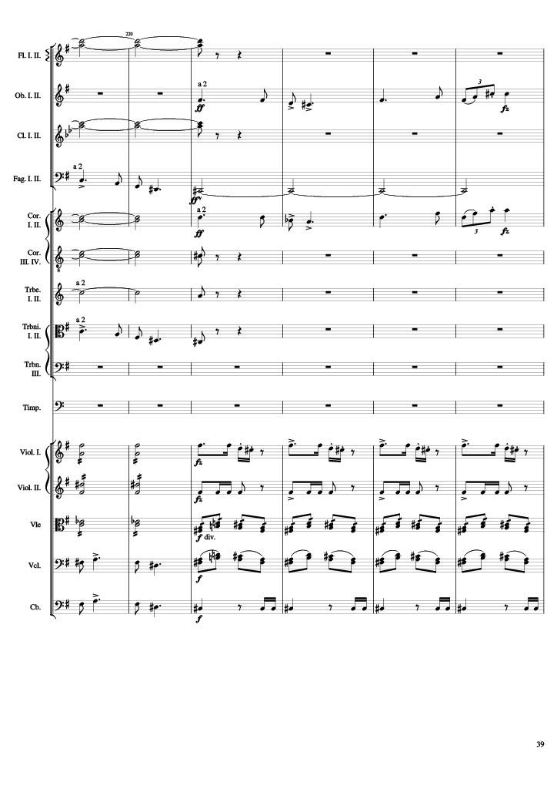
harm
mel
harm
mel
harm
mel
harm
harm
mel
rhythm
mel+rhythm
rhythm
rhythm
mel
rhythm
mel
rhythm
Notes:
742-754
7:52

Slide 40
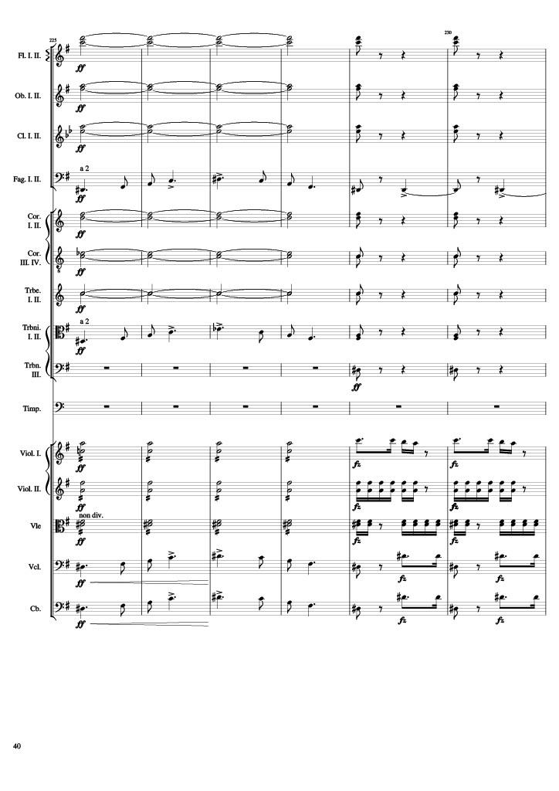
harm
rhythm+harm
harm
rhythm+harm
harm
rhythm+harm
mel
rhythm
harm
rhythm+harm
harm
rhythm+harm
harm
rhythm+harm
mel
rhythm+harm
rhythm+harm
rhythm
mel
rhythm
rhythm
rhythm
rhythm
mel
rhythm
mel
rhythm
Notes:
754-766
7:58

Slide 41
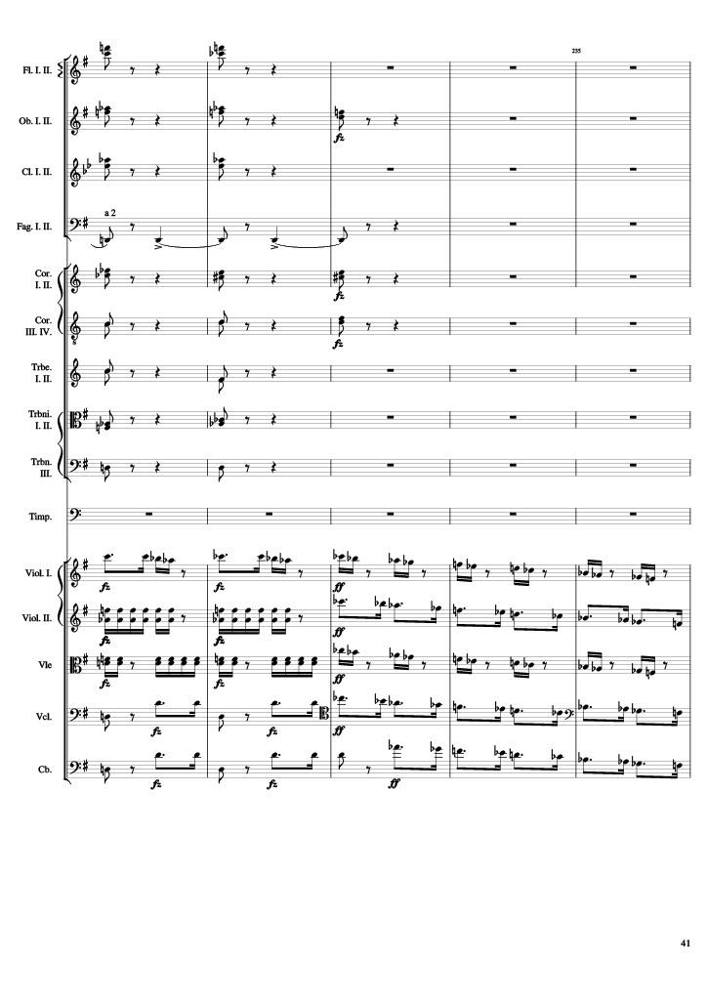
rhythm+harm
rhythm+harm
rhythm+harm
rhythm
rhythm+harm
rhythm+harm
rhythm+harm
rhythm+harm
rhythm+harm
mel
rhythm
mel
rhythm
mel
rhythm
mel
rhythm
mel
Notes:
766-776
8:04

Slide 42
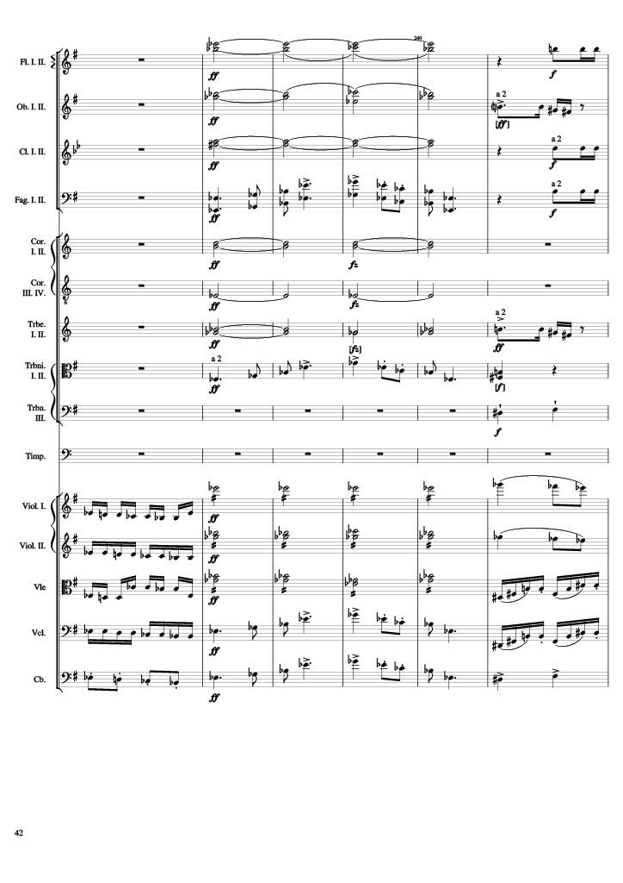
harm
rhythm
harm
rhythm
harm
rhythm
mel
rhythm
harm
harm
harm
rhythm
mel
rhythm+harm
rhythm+harm
mel
rhythm
mel
mel
rhythm
mel
mel
rhythm
rhythm
mel
mel
rhythm
mel
mel
rhythm+harm
Notes:
776-788
8:09

Slide 43
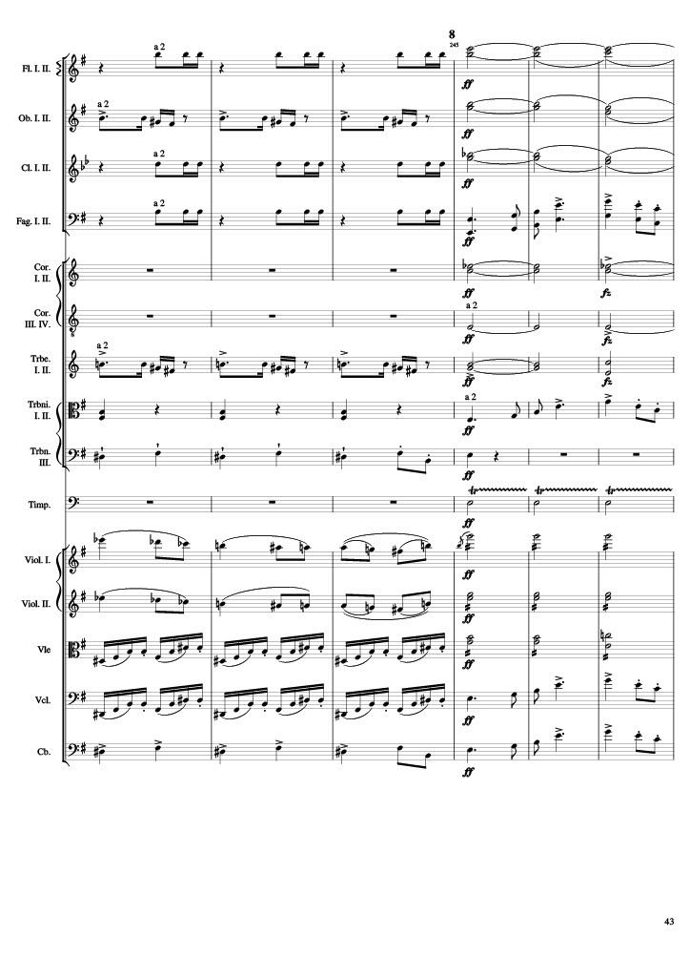
rhythm
harm
rhythm
harm
rhythm
harm
rhythm
mel
harm
harm
rhythm
harm
rhythm+harm
mel
rhythm+harm
rhythm
mel
rhythm
mel
rhythm
rhythm
rhythm
rhythm
mel
rhythm+harm
mel
Notes:
788-800
8:15

Slide 44
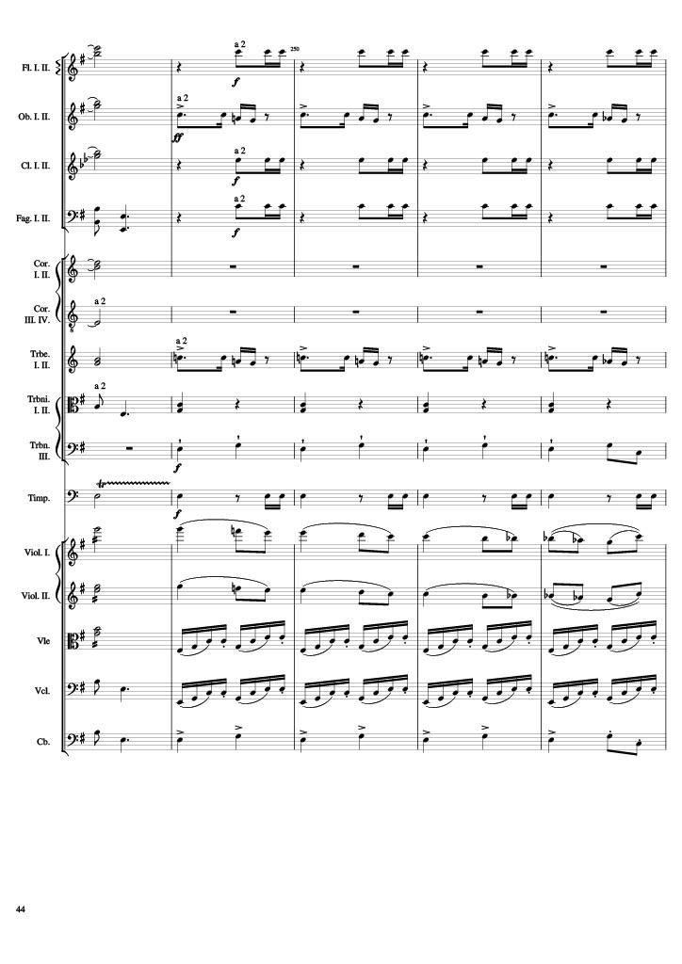
harm
rhythm
harm
rhythm
harm
rhythm
mel
rhythm
harm
harm
harm
rhythm
mel
rhythm+harm
rhythm+harm
rhythm
rhythm
rhythm
mel
rhythm
mel
rhythm
rhythm
mel
rhythm
mel
rhythm+harm
Notes:
800-810
8:20

Slide 45
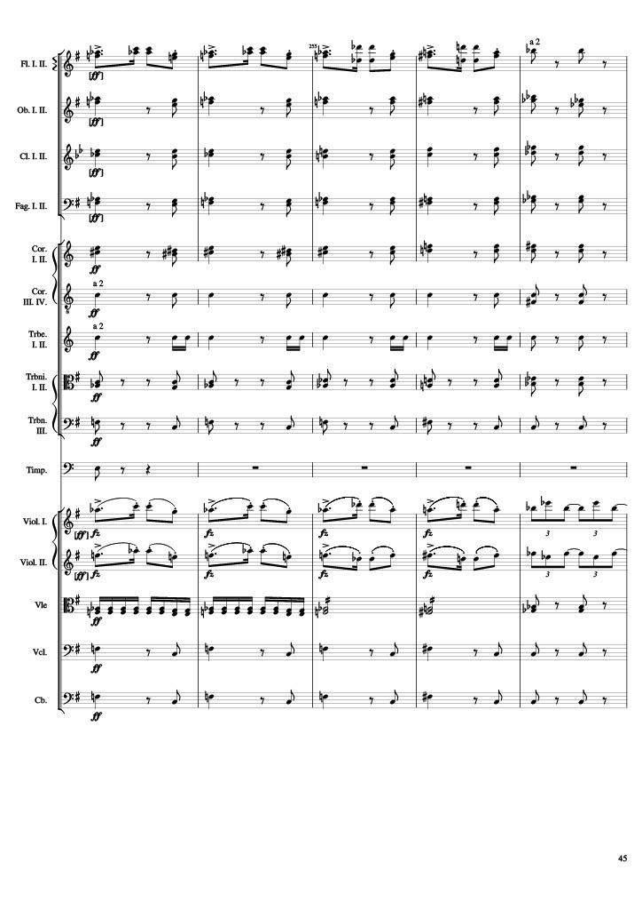
mel
rhythm+harm
rhythm+harm
rhythm+harm
rhythm+harm
rhythm+harm
rhythm+harm
rhythm+harm
rhythm+harm
rhythm+harm
rhythm
mel
mel
rhythm
rhythm+harm
rhythm+harm
rhythm+harm
Notes:
810-820
8:25

Slide 46
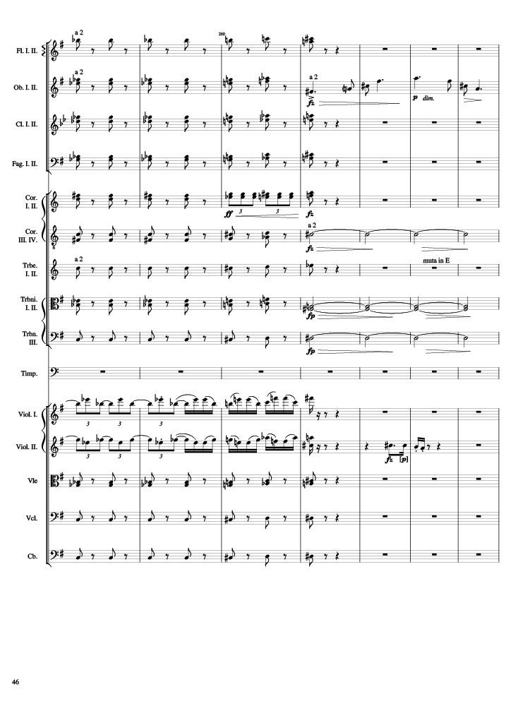
rhythm+harm
rhythm+harm
mel
rhythm+harm
rhythm+harm
rhythm+harm
rhythm+harm
harm
rhythm+harm
rhythm+harm
harm
rhythm+harm
harm
mel
mel
mel
rhythm+harm
rhythm+harm
rhythm+harm
Notes:
820-834
8:29

Slide 47
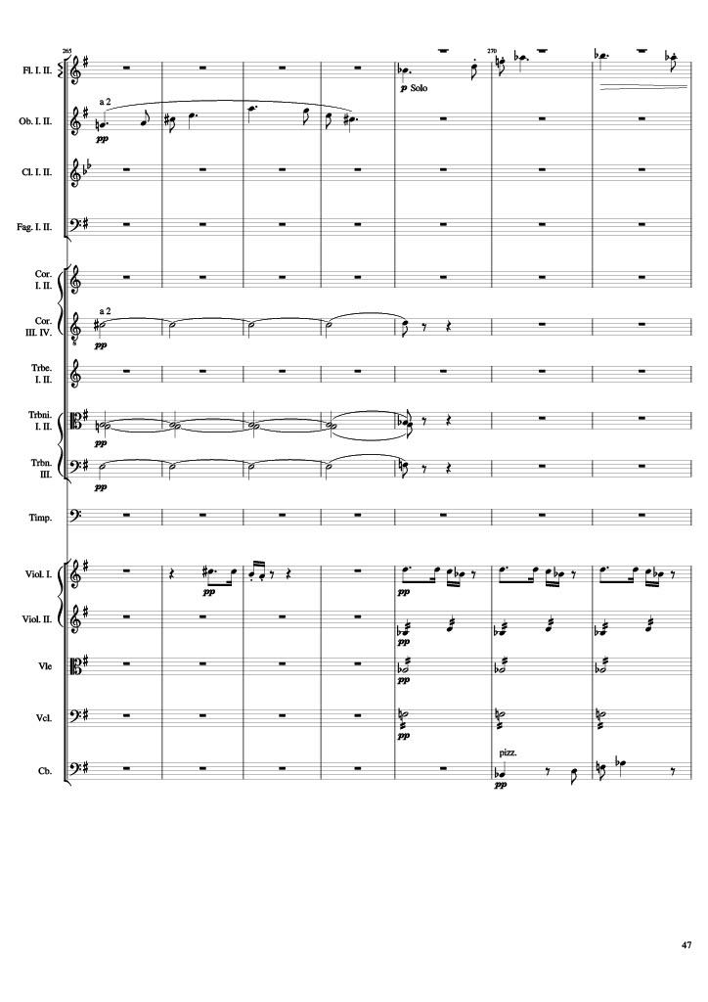
mel
mel
harm
harm
harm
mel
mel+rhythm
rhythm
rhythm
rhythm
mel+rhythm
Notes:
834-848
8:36

Slide 48
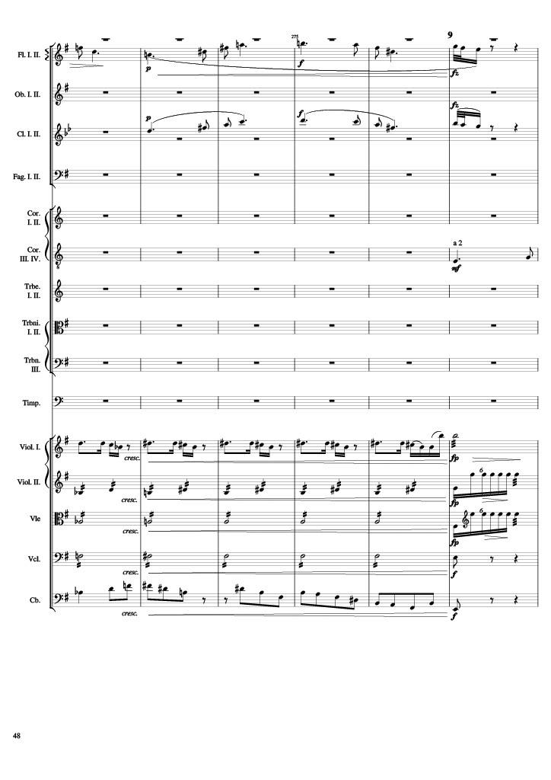
mel
mel
mel
mel+rhythm
rhythm
rhythm
rhythm
rhythm
mel+rhythm
Notes:
848-860
8:43

Slide 49
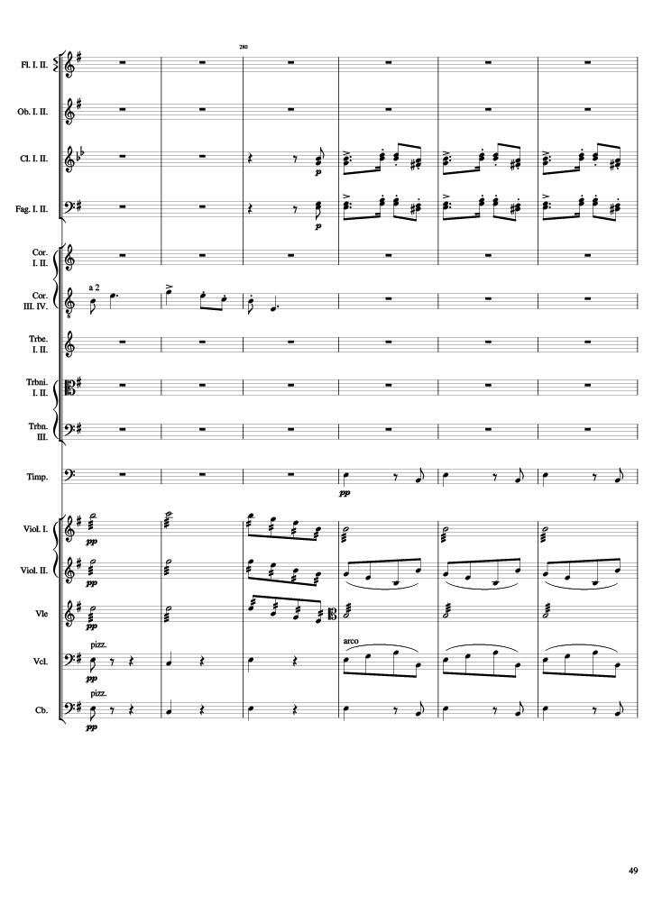
mel
mel
mel
rhythm+harm
rhythm
rhythm
rhythm
rhythm+harm
rhythm
rhythm+harm
Notes:
860-872
8:50

Slide 50
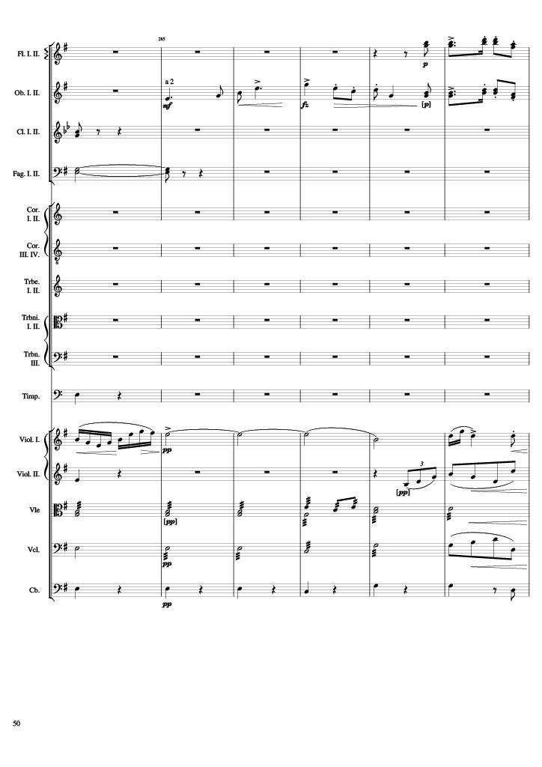
mel
mel
mel
mel
rhythm+harm
mel
rhythm
rhythm
rhythm
rhythm
rhythm
rhythm+harm
Notes:
872-884
8:54

Slide 51

mel
mel
harm
harm
harm
harm
harm
harm
harm
harm
rhythm
rhythm
mel
rhythm
mel
rhythm
mel
rhythm
mel
rhythm+harm
mel
Notes:
884-896
9:00

Slide 52

harm
rhythm+harm
harm
rhythm+harm
harm
rhythm+harm
harm
rhythm+harm
harm
rhythm+harm
harm
rhythm+harm
harm
rhythm+harm
harm
rhythm+harm
mel
mel
mel
mel
rhythm
mel
rhythm
Notes:
896-910
9:06

Slide 53

mel
mel
mel
rhythm
rhythm
Notes:
910-920
9:12

Slide 54

mel
mel
mel
rhythm
rhythm
Notes:
920-932
9:17

Slide 55

mel
mel
harm
mel
harm
mel
harm
harm
rhythm
Notes:
932-942
9:23

Slide 56

mel
harm
harm
harm
harm
rhythm
Notes:
942-952
9:28

Slide 57

mel
mel
mel
rhythm+harm
harm
harm
rhythm
harm
rhythm
Notes:
952-964
9:33

Slide 58

mel
harm
harm
mel
mel
harm
rhythm+harm
harm
harm
rhythm
harm
mel
rhythm
harm
mel
rhythm
mel
Notes:
964-976
9:39

Slide 59

rhythm+harm
rhythm+harm
mel
mel
rhythm+harm
mel
mel
mel
mel
rhythm
rhythm
harm
harm
Notes:
976-984
9:45

Slide 60

rhythm
rhythm
rhythm
mel
mel
rhythm
rhythm
harm
Notes:
984-992
9:49

Slide 61

rhythm
rhythm
rhythm
rhythm
harm
harm
harm
harm
mel
mel
rhythm
rhythm
harm
rhythm
Notes:
992-1000
9:53

Slide 62

rhythm
rhythm
rhythm
rhythm
harm
harm
harm
harm
mel
rhythm
mel
rhythm
rhythm
rhythm
mel
rhythm
mel
Notes:
1000-1008
9:57

Slide 63

rhythm
mel
rhythm
mel
rhythm
mel
rhythm
mel
rhythm
mel
harm
mel
rhythm
Notes:
1008-1016
10:01

Slide 64

mel
rhythm
mel
rhythm
mel
mel
rhythm
mel
rhythm
rhythm
harm
rhythm
mel
Notes:
1016-1026
10:05

Slide 65

rhythm
mel
rhythm
mel
mel
rhythm
mel
rhythm
mel
rhythm
harm
mel
rhythm
Notes:
1026-1036
10:10

Slide 66

mel
mel
mel
mel
rhythm
mel
harm
rhythm
Notes:
1036-1052
10:15

Slide 67

mel
harm
mel
harm
harm
harm
Notes:
1052-1068
10:24

Slide 68

rhythm
rhythm+harm
rhythm
rhythm+harm
mel
mel
rhythm
harm
rhythm+harm
Notes:
1068-1082
10:34

Slide 69

rhythm+harm
rhythm+harm
mel
mel
rhythm
rhythm
rhythm
Notes:
1082-1092
10:43

Slide 70

harm
harm
rhythm
harm
rhythm
harm
mel
mel
mel
rhythm
mel
rhythm
rhythm
rhythm
rhythm
harm
rhythm
harm
Notes:
1092-1104
10:48

Slide 71

harm
rhythm+harm
harm
rhythm+harm
harm
rhythm+harm
harm
rhythm+harm
harm
rhythm+harm
harm
rhythm+harm
mel
rhythm+harm
harm
mel
rhythm+harm
harm
rhythm+harm
rhythm
rhythm
mel
rhythm
mel
rhythm
rhythm+harm
rhythm
rhythm+harm
rhythm
rhythm+harm
Notes:
1104-1122
10:54

Slide 72

rhythm+harm
harm
rhythm+harm
harm
rhythm+harm
harm
rhythm+harm
harm
rhythm+harm
harm
rhythm+harm
harm
rhythm+harm
harm
rhythm+harm
harm
rhythm+harm
harm
rhythm
mel
mel+rhythm
mel
mel+rhythm
rhythm+harm
rhythm
rhythm+harm
rhythm
rhythm+harm
rhythm
Notes:
1122-1136
11:03

Slide 73

rhythm+harm
rhythm+harm
rhythm+harm
rhythm+harm
rhythm+harm
rhythm+harm
rhythm
rhythm+harm
rhythm+harm
rhythm
mel
mel
rhythm
harm
harm
Notes:
1136-1152
11:10

Slide 74

rhythm+harm
mel
rhythm+harm
rhythm+harm
rhythm+harm
rhythm+harm
rhythm+harm
rhythm+harm
rhythm+harm
rhythm+harm
rhythm+harm
mel+rhythm
mel+rhythm
mel+rhythm
rhythm+harm
mel+rhythm
rhythm+harm
rhythm+harm
Notes:
1152-1166
11:18

Slide 75

rhythm+harm
mel
rhythm+harm
mel
rhythm+harm
mel
rhythm+harm
mel
rhythm+harm
rhythm+harm
rhythm+harm
rhythm+harm
rhythm+harm
rhythm+harm
mel+rhythm
mel
mel+rhythm
mel
rhythm+harm
rhythm
rhythm+harm
rhythm
rhythm+harm
rhythm
Notes:
1166-1180
11:24

Slide 76

rhythm
harm
rhythm
rhythm
harm
rhythm
rhythm
harm
rhythm
rhythm
harm
harm
rhythm
harm
harm
rhythm
harm
harm
rhythm
harm
rhythm
rhythm
mel
rhythm
rhythm
rhythm
rhythm
mel
rhythm
mel
rhythm
rhythm
rhythm
rhythm
mel
rhythm
rhythm
mel
rhythm
Notes:
1180-1194
11:29

Slide 77

rhythm
rhythm+harm
rhythm
rhythm+harm
rhythm
rhythm+harm
harm
rhythm+harm
harm
rhythm+harm
harm
rhythm+harm
rhythm
rhythm+harm
rhythm
rhythm+harm
rhythm+harm
rhythm
rhythm+harm
rhythm
rhythm+harm
rhythm
rhythm+harm
rhythm
rhythm+harm
rhythm
rhythm+harm
rhythm
rhythm+harm
Notes:
1194-1210
11:36

